Slide 1
Shallow Artificial Neural Networks for Forecasting
Prof. Dr. Erol Egrioglu
Giresun University, Department of Statistics, Turkey
(Visiting Researcher for CMAF)
Notes:
The title of my presentation is «Shallow Artificial Neural Networks for Forecasting». Recent years, complicated methods like ANNs have been used for modelling because of computers power. ANNs looks powerful tools for forecasting aims in the literature. In this talk, performances of three shallow ANNs will show by using forecast competition data sets. Different strategies for automatic forecasting are compared. Results of deep and shallow ANNs are also compared. Aim of this talk is discussing following questions:
Have Shallow ANNs satisfactory forecasting performance?
Which automatic forecasting strategy can be preferred for shallow ANNs?
Which pre-processing methods can be preferred in shallow ANNs?
Which one is better Shallow or deep ANNs?

Slide 2
Can shallow ANNs produce satisfactory forecasting performance for forecast competition data sets?
Which automatic forecasting strategy can be preferred for shallow ANNs?
Which pre-processing methods can be preferred in shallow ANNs?
Is Shallow ANNs better than other ML methods?

Slide 3
Presentation Plan
  Summarizing
    Single multiplicative neuron model ANN (SMNM-ANN)
    Pi-Sigma ANN (PS-ANN)
    Dendritic Neuron model ANN (DN-ANN)
  Introducing Automatic Forecasting Methods for SMNM-ANN, PS-ANN and DN-ANN
  Exploring Performance of SMNM-ANN, PS-ANN and DN-ANN for competition Data Sets
  Discussions

Slide 4
Artificial Neural Networks
Architecture
Deep
Shallow
Architecture
Feed-forward
Recurrent
Architecture
Fully Connected
Partially Connected

Slide 5
Artificial Neural Networks
Deep ANN
Needs more data
Shallow ANN
Can work less data
Use many parameters
Use appropriate number of parameters
Good for Big Data (Image Processing, Global Models)
Good performance for appropriate number of data
Simple model structure

Slide 6
Deep ANNs
MLP with hidden layers (more than one)
Recurrent ANNs (LSTM, GRU)
Convolutional ANNs

Slide 7
Shallow ANNs
Multilayer Perceptron (MLP)
Support Vector Machines
Elman Type Recurrent ANN
Jordan Type Recurrent ANN
Radial Basis ANN

Slide 8
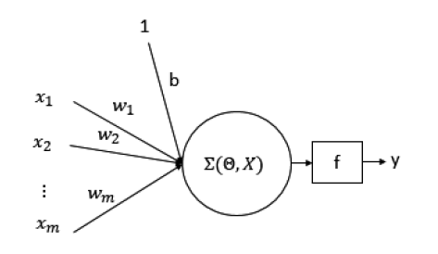
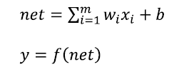
Artificial Neuron Models
It cannot solve XOR Problem
Mc-Culloch and Pitts (Additive)
Simple Perceptron

Slide 9
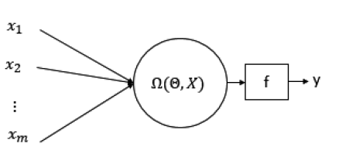
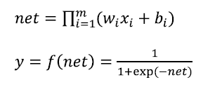
Artificial Neuron Models
It can solve XOR Problem
Multiplicative Neuron Model
SMNM-ANN

Slide 10
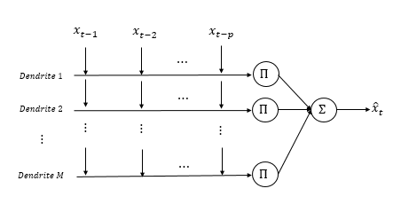







Artificial Neuron Models
$$x_{1}$$
$$x_{2}$$
$$x_{n}$$
(Synaptic Function)
O
(Dendritic Function)
(Membrane Function)
Dendritic Neuron Model
(Soma Function)

Slide 11
Three Shallow ANNs

Slide 12
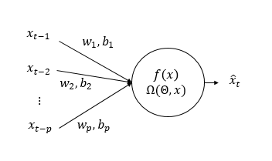
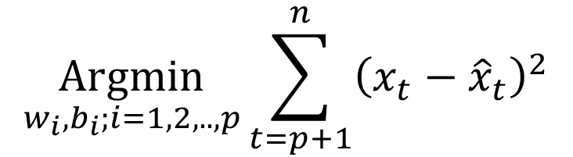
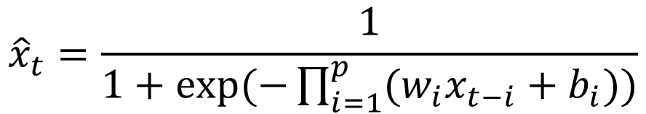
SMNM-ANN for Forecasting
$${\hat{x}}_{t}=\frac{1}{1+exp⁡(−\prod_{i=1}^{p}{({w_{i}x}_{t−i}+b_{i}))}}$$
$$\underset{w_{i},b_{i};i=1,2,..,p}{Argmin}{\sum_{t=p+1}^{n}{{\left(x_{t}−{\hat{x}}_{t}\right)}^{2}}}$$

Slide 13
Training of SMNM-ANN
Modified PSO
Dynamic inertia weights
Restarting strategy
Every 100 iteration, new initialization for weights and biases
Early Stopping Rule
Successive 30 failure to update the best result
Dynamic social and cognitive coefficients

Slide 14
Training of SMNM-ANN
Modified PSO
Objective Function
Derivate free method
Robust Error Metrics
Quick and stable training
Avoid local Optimum Trap

Slide 15
Pre-processing for SMNM-ANN
Seasonal Differencing
Differencing
Normalization
De-seasonalization
De-trending
Normalization

Slide 16


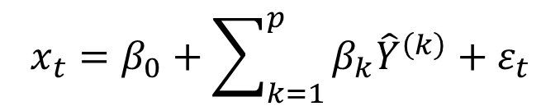
Model Adequacy and Input Significance for SMNM-ANN
$${\hat{x}}_{t}=f\left(x_{t−1},…,x_{t−p} ; {\hat{w}}_{1},{\hat{w}}_{2},…,{\hat{w}}_{p},{\hat{b}}_{1},{\hat{b}}_{2},…,{\hat{b}}_{p}\right)$$
$${\hat{Y}}^{(k)}=f\left(\left.x_{t−1}=mean\left(x_{t−1}\right),x_{t−2}=mean\left(x_{t−2}\right),…,x_{t−k},…,x_{t−p+1}=mean\left(x_{t−p+1}\right),x_{t−p}=mean(x_{t−p}\right)\right)$$
$$x_{t}=β_{0}+\sum_{k=1}^{p}{β_{k}{\hat{Y}}^{\left(k\right)}}+ε_{t}$$
Model Adequacy
Input Significance

Slide 17
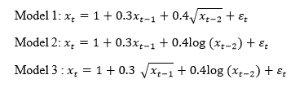
Model | Significance Level | Model Adequacy Test | Input Significance Tests
 |  |  | x(t-1) | x(t-2) | x(t-3) | x(t-4)
Model 1 | 0,01 | 100,00% | 100,00% | 57,40% | 99,00% | 98,90%
Model 1 | 0,05 | 100,00% | 100,00% | 76,80% | 95,50% | 95,70%
Model 1 | 0,10 | 100,00% | 100,00% | 85,60% | 91,20% | 90,00%
Model 2 | 0,01 | 100,00% | 100,00% | 98,40% | 99,30% | 91,30%
Model 2 | 0,05 | 100,00% | 100,00% | 99,60% | 95,40% | 95,60%
Model 2 | 0,10 | 100,00% | 100,00% | 99,70% | 88,40% | 99,20%
Model 3 | 0,01 | 99,90% | 49,80% | 100,00% | 98,80% | 99,00%
Model 3 | 0,05 | 100,00% | 72,30% | 100,00% | 95,20% | 95,30%
Model 3 | 0,10 | 100,00% | 82,80% | 100,00% | 89,70% | 90,50%

Slide 18
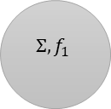


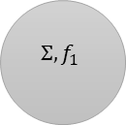
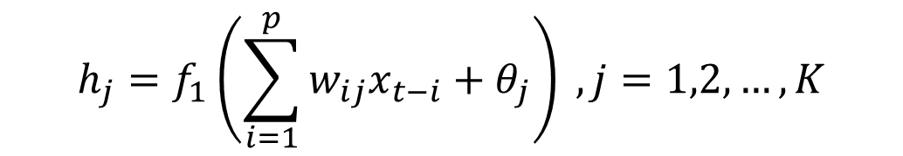
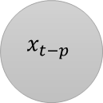

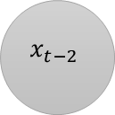
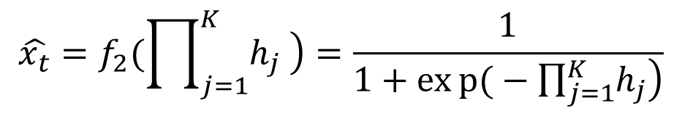

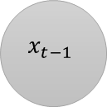
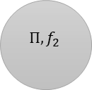
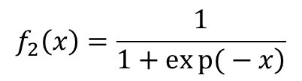
PS-ANN for Forecasting
$$θ_{1}$$
$$x_{t−1}$$
$$Σ,f_{1}$$
1
$$x_{t−2}$$
$$Σ,f_{1}$$
$$Π, f_{2}$$
$$h_{j}=f_{1}\left(\sum_{i=1}^{p}{w_{ij}x_{t−i}+θ_{j}}\right) , j=1,2,…,K$$
1
$$\hat{x_{t} }$$
1
$$\hat{x_{t}}=f_{2}(\prod_{j=1}^{K}{\left.h_{j} \right)}=\frac{1}{1+exp{(}−\prod_{j=1}^{K}{\left.h_{j}\right)}}$$
$$x_{t−p}$$
$$Σ,f_{1}$$
W
$$θ_{K}$$
$$f_{2}\left(x\right)=\frac{1}{\left.1+exp{(}−x\right)}$$
$$f_{1}\left(x\right)=x$$

Slide 19
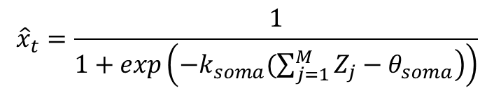
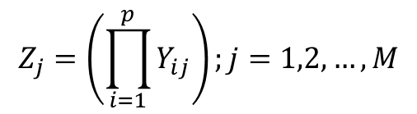
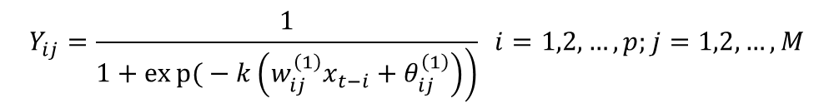
DNM-ANN for Forecasting
$$Y_{ij}=\frac{1}{\left.1+exp{(}−k\left(w_{ij}^{\left(1\right)}x_{t−i}+θ_{ij}^{\left(1\right)}\right)\right)} i=1,2,…,p;j=1,2,…,M$$
$$Z_{j}=\left(\prod_{i=1}^{p}{Y_{ij}}\right);j=1,2,…,M$$
$${\hat{x}}_{t}=\frac{1}{1+exp\left(\left.−k_{soma}(\sum_{j=1}^{M}{Z_{j}−θ_{soma}}\right)\right)}$$

Slide 20
Automatic Forecasting Methods Based on SMNM-ANN, PS-ANN, DNM-ANN
AFM-(SMNM;PS;DNM)-ANN-1: Pre-processing (differencing operations) and fixed architecture
AFM- (SMNM;PS;DNM) -ANN-2: Pre-processing (differencing operations) and architecture selection based on validation data set
AFM- (SMNM;PS;DNM) -ANN-3: Pre-processing (differencing operations) and architecture selection based on input significance tests
AFM- (SMNM;PS;DNM) -ANN-4: Pre-processing (detrend and deseasonalization operations) and architecture selection based on input significance tests

Slide 21
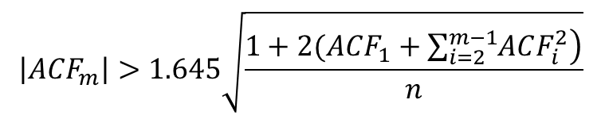
AFM-SMNM-ANN-1
Start
$$\left|ACF_{m}\right|>1.645\sqrt{\frac{1+2(ACF_{1}+\sum_{i=2}^{m−1}{\left.ACF_{i}^{2}\right)}}{n}}$$
Seasonal Differencing
Calculate Forecasts
End
Train SMNM-ANN with predetermined architecture by PSO
Differencing

Slide 22
AFM-SMNM-ANN-2
Start
Calculate Forecasts
End
Seasonal Differencing
Select the best architecture
Calculate Validation Data Performance for All Candidates
Differencing
Train SMNM-ANN for candidate architectures by PSO
A set is determined for the candidate architectures

Slide 23
AFM-SMNM-ANN-3
Start
Calculate Forecasts
End
Yes
Seasonal Differencing
Are all inputs significant?
No
Exclude insignificant inputs
Differencing
Apply input significance tests
Determining lagged variables (inputs) by using significant partial autocorrelations
Train SMNM-ANN by PSO

Slide 24
AFM-SMNM-ANN-4
Start
Calculate Forecasts
End
Yes
Seasonal Adjustment (Winters Multiplicative ES Method)
Are all inputs significant?
No
Exclude insignificant inputs
De-trend
(Linear Regression)
Apply input significance tests
Determining lagged variables (inputs) by using significant partial autocorrelations
Train SMNM-ANN by PSO

Slide 25
Exploring Forecasting Performances
Computational Intelligence in Forecasting Competition 2016
M4 Competition (Weekly, Hourly, Daily Time Series)

Slide 26
CIF 2016

Slide 28
M4 Competition Hourly Data Results

Slide 29
Rank=12
Among 61 Methods in M4

Slide 32
M4 Competition Weekly Data Results

Slide 33
Rank=42

Slide 35
M4 Competition Daily Data Results

Slide 36
Rank=32

Slide 38
Comparison with the best method

Slide 39
Conclusions
Strategy 1 and Strategy 3 are the best strategies.
Strategy 3 brings a statistical perspective to ANN models.
Strategy 2 is tried for CIF2016 and it is not better than Strategy 1 and 3.
Strategy 4 looks generally the worst strategy.
Performances of SMNM, PS and DNM ANNs are better than MLP and RNN benchmarks.
Performance of the strategies are varying according to ANN type and data type.
Pre-processing methods are important for the performance of ANNs.
SMNM can produce competitive results against the winner method.

Slide 40
Future Researches for SMNM, PS and DNM
Outliers and change points did not take into consideration in the strategies. This can be increase the performance.
Ensemble strategies are useful in M4 and can be considered.
Different pre-processing methods can be considered.
Global models can be obtained by using SMNM,PS and DNM.
Hybridization of statistical methods and SMNM,PS and DNM can be useful.

Slide 41
References
Yadav, R.N., Kalra, P.K., & John, J. (2007). Time series prediction with single multiplicative neuron model. Applied Soft Computing, 7, 1157-1163.
Y. Todo, H. Tamura, K. Yamashita, and Z. Tang, “Unsupervised learnable neuron model with nonlinear interaction on dendrites,” Neural Networks, vol. 60, pp. 96–103, Dec. 2014.
Shin, Y., Gosh, J. (1991). The Pi sigma Network: An efficient higher order neural network for pattern classification and function approximation. In Proceedings of the International Joint Conference on Neural Networks.
Mohammadi, S. (2018). A new test for the significance of neural network inputs. Neurocomputing, 273, 304-322.
Makridakis, S. Spiliotis, E., & Assimakopoulos, V. (2020). The M4 Competition: 100,000 time series and 61 forecasting methods, International Journal of Forecasting, 36, 54–74.

